Slide 1

基于深度神经网络的谱聚类算法研究
Unsupervised meta-learning
昝畅通
20200514

Slide 2
Content
01 UMTRA
02 FIGR
03 our work
工作进度计划

Slide 3
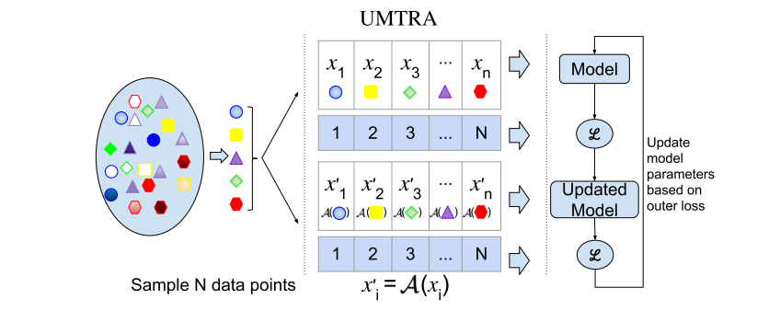
UMTRA
Unsupervised Meta-learning with Tasks constructed by Random sampling and Augmentation (UMTRA) that performs meta-learning of one-shot or few-shot classifiers in an unsupervised manner on an unlabeled dataset.
In order to be able to run the UMTRA algorithm on unsupervised data, we need to create tasks T from the unsupervised data that can serve the same role as the meta-learning tasks serve in the full MAML algorithm.
Khodadadeh S, Boloni L, Shah M. Unsupervised Meta-Learning for Few-Shot Image Classification[C]//Advances in Neural Information Processing Systems. 2019: 10132-10142.

Slide 4
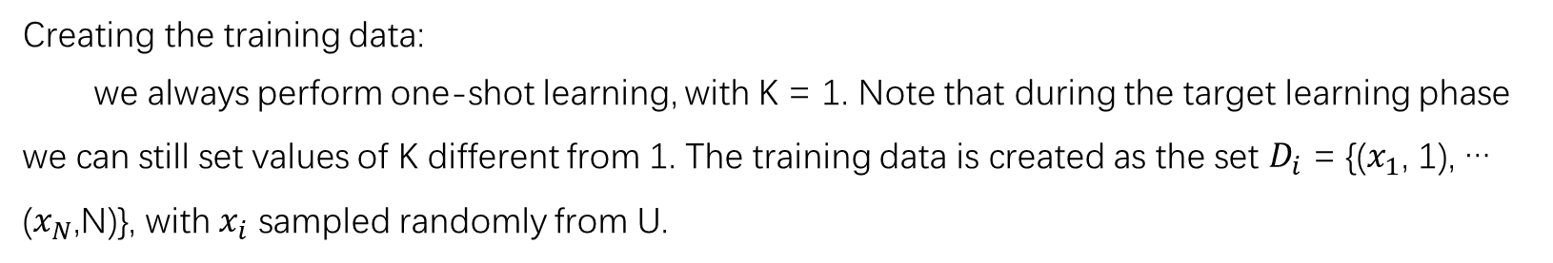
UMTRA
Creating the training data:
we always perform one-shot learning, with K = 1. Note that during the target learning phase we can still set values of K different from 1. The training data is created as the set $D_{i}$ = {($x_{1}$, 1), … ($x_{N}$,N)}, with $x_{i}$ sampled randomly from U.
How this training data construction satisfy the class distinction conditions?
1. The first condition is satisfied because there is only one sample for each label.
2. The second condition is satisfied statistically by the fact that N << c, where c is the total number of classes in the dataset.
If we assume that the samples are equally distributed among the classes (e.g. m samples for each class), the probability that all samples are in a different class is equal to
$$P = \frac{(c · m) · ((c − 1) · m)...((c −N + 1) · m)}{(c · m) · (c · m− 1)...(c · m−N + 1)} = \frac{c! · mN · (c · m−N)!}{(c −N)! · (c · m)!}$$

Slide 5
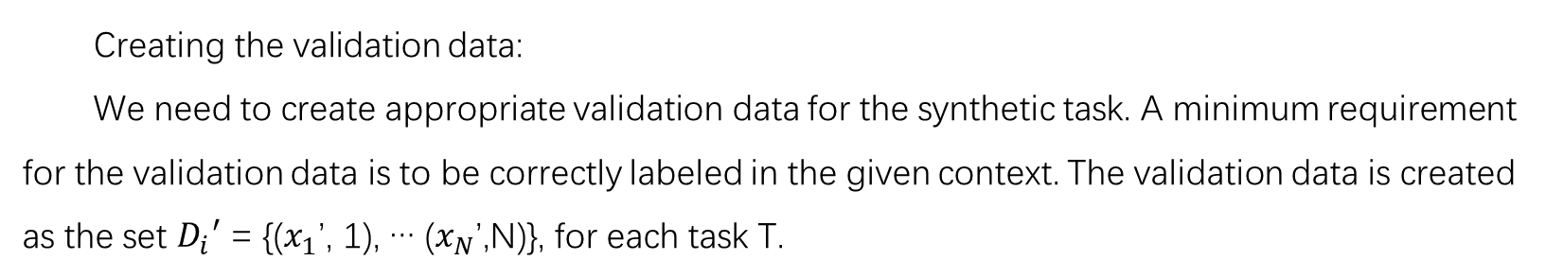
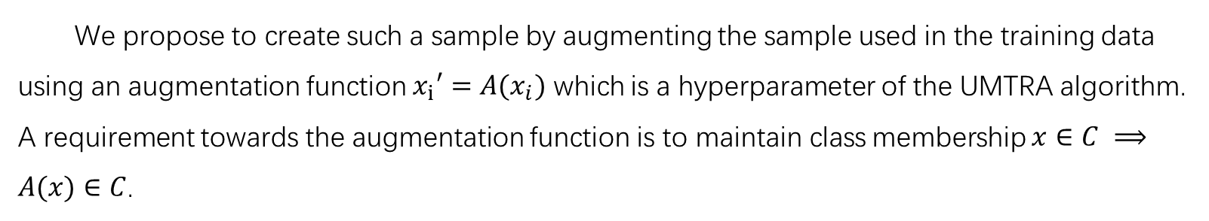
UMTRA
Creating the validation data:
We need to create appropriate validation data for the synthetic task. A minimum requirement for the validation data is to be correctly labeled in the given context. The validation data is created as the set $D_{i}′$ = {($x_{1}$’, 1), … ($x_{N}$’,N)}, for each task T.
We propose to create such a sample by augmenting the sample used in the training data using an augmentation function $x_{i}′=A(x_{i})$ which is a hyperparameter of the UMTRA algorithm. A requirement towards the augmentation function is to maintain class membership $x∈C ⟹A(x)∈C$.
Some examples: flip, grayscale, rotate, auto augment, translation + zeroing pixels

Slide 6
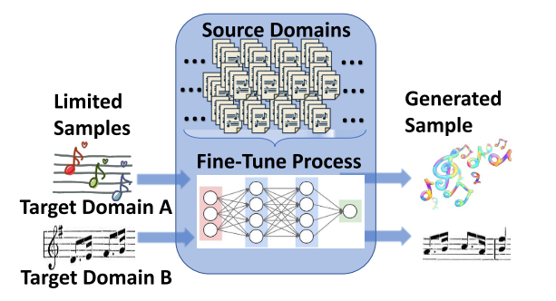
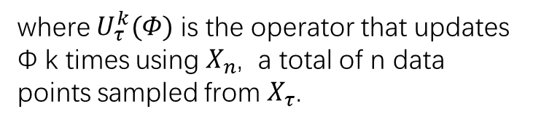

FIGR
This paper propose Few-shot Image Generation using Reptile (FIGR), a GAN meta-trained with Reptile. This model successfully generates novel images on both MNIST and Omniglot with as little as 4 images from an unseen class.
The goal of Few-shot image generation is :
$${minimize}_{Φ}E_{τ} [L_{τ}(U_{τ}^{k}(Φ))]$$
where $U_{τ}^{k}(Φ)$ is the operator that updates Φ k times using $X_{n}$, a total of n data points sampled from $X_{τ}$.
Cloutre L , Demers M . FIGR: Few-shot Image Generation with Reptile[J]. 2019.

Slide 7
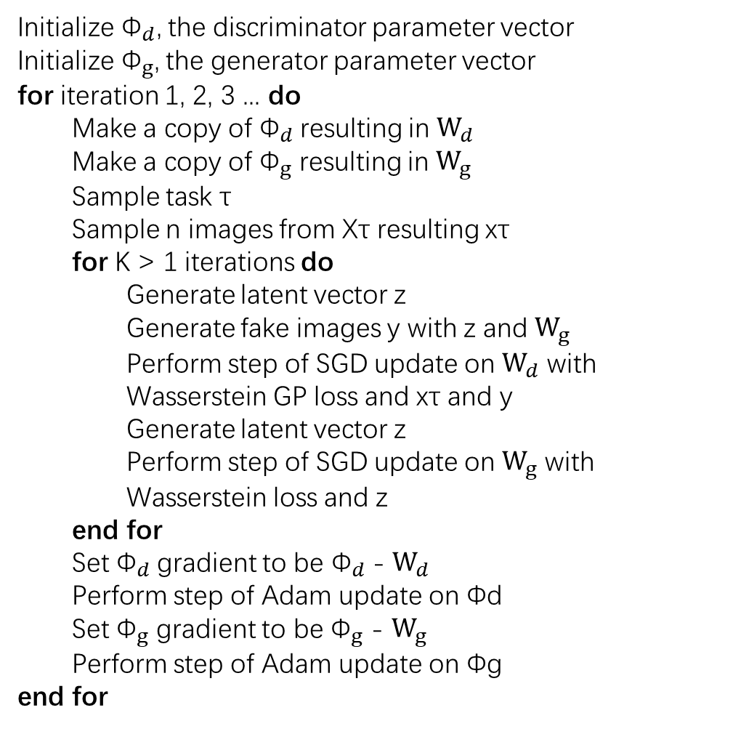
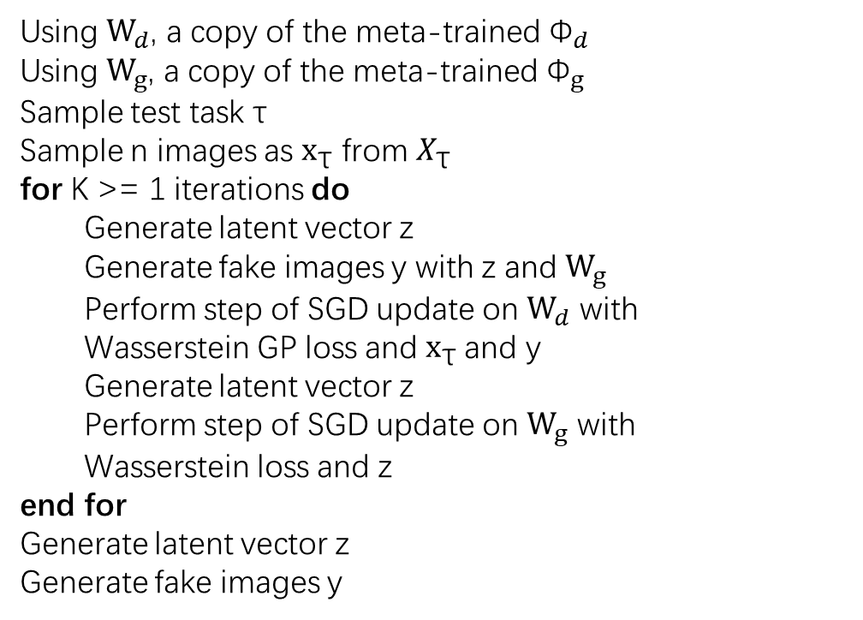
FIGR
Initialize ${\text{Φ}}_{d}$, the discriminator parameter vector
Initialize ${\text{Φ}}_{g}$, the generator parameter vector
for iteration 1, 2, 3 ... do
Make a copy of ${\text{Φ}}_{d}$resulting in ${\text{W}}_{d}$
Make a copy of ${\text{Φ}}_{g}$ resulting in ${\text{W}}_{g}$
Sample task τ
Sample n images from Xτ resulting xτ
for K > 1 iterations do
Generate latent vector z
Generate fake images y with z and ${\text{W}}_{g}$
Perform step of SGD update on ${\text{W}}_{d}$ with
Wasserstein GP loss and xτ and y
Generate latent vector z
Perform step of SGD update on ${\text{W}}_{g}$ with
Wasserstein loss and z
end for
Set ${\text{Φ}}_{d}$gradient to be ${\text{Φ}}_{d}$- ${\text{W}}_{d}$
Perform step of Adam update on Φd
Set ${\text{Φ}}_{g}$ gradient to be ${\text{Φ}}_{g}$ - ${\text{W}}_{g}$
Perform step of Adam update on Φg
end for
Using ${\text{W}}_{d}$, a copy of the meta-trained ${\text{Φ}}_{d}$
Using ${\text{W}}_{g}$, a copy of the meta-trained ${\text{Φ}}_{g}$
Sample test task τ
Sample n images as $x_{\text{τ}}$ from $X_{\text{τ}}$
for K >= 1 iterations do
Generate latent vector z
Generate fake images y with z and ${\text{W}}_{g}$
Perform step of SGD update on ${\text{W}}_{d}$ with
Wasserstein GP loss and $x_{\text{τ}}$and y
Generate latent vector z
Perform step of SGD update on ${\text{W}}_{g}$ with
Wasserstein loss and z
end for
Generate latent vector z
Generate fake images y

Slide 8
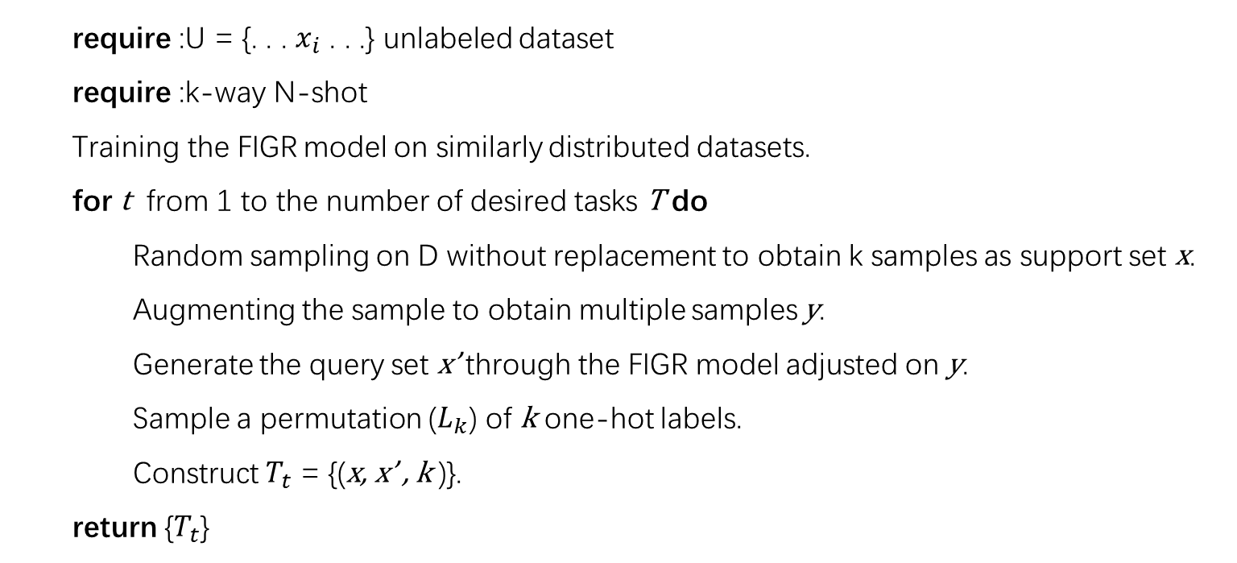
Our work
Unsupervised meta-learning via Generative Adversarial Networks
require :U = {. . . $x_{i}$ . . .} unlabeled dataset
require :k-way N-shot
Training the FIGR model on similarly distributed datasets.
for t from 1 to the number of desired tasks T do
Random sampling on D without replacement to obtain k samples as support set x.
Augmenting the sample to obtain multiple samples y.
Generate the query set x’ through the FIGR model adjusted on y.
Sample a permutation ($L_{k}$) of k one-hot labels.
Construct $T_{t}$ = {(x, x’ , k )}.
return {$T_{t}$}

Slide 9
Our work
How to split the dataset？
How to get the code of other generative models？
Is it possible to use task diversity to predict the final effect?

Slide 10
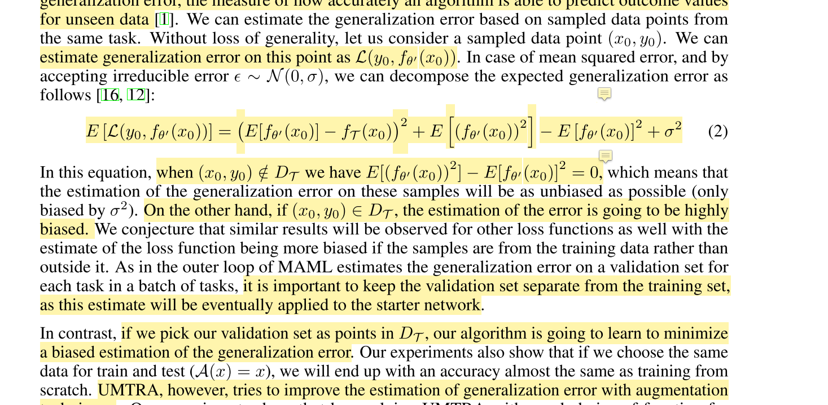
Our work

Slide 11
Thanks

